Slide 1


WEEKLY TASKS
OT RnD TEAM
OPERATION TECHNOLOGY
17.10.26
Presented by
OT RnD Team

Slide 2
List of projects under OT - RnD team
S.no | Project | Start Date | Target End Date
1 | Gateway Device | 25.07.26 | 01.01.27
2 | Air bag Stitch inspection | 08.09.26 | 31.10.26
3 | Robot frimware development | 01.11.26 | 01.02.27

Slide 3
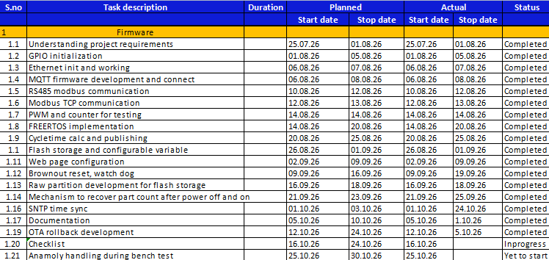
WBS gateway - Firmware

Slide 4
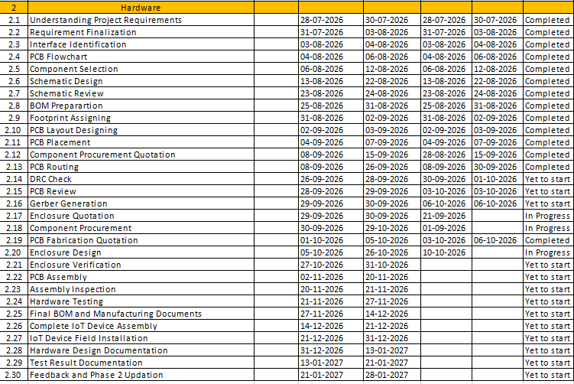
WBS gateway - Hardware

Slide 5
Planned tasks
S NO | NAME | PROJECT | PLAN TASK | START DATE | END DATE | COMMENTS
1 | Rithani | Industrial Robot | Learning ROS 2, and try a basic project | 12.10.26 | 17.10.26
2 | Rithani | Industrial Robot | Documentation of robot requirements | 12.10.26 | 14.10.26
Actual tasks
S NO | NAME | PROJECT | TASK | START DATE | END DATE | COMMENTS
1 | Rithani | Industrial Robot | Searching for outsourcing vendors of robot components | 12.10.26 | 13.10.26
2 | Rithani | Air bag Stitch inspection | Remote destop enabling in pi, camera interfacing trial in pi | 14.10.26 | 14.10.26
3 | Rithani | Gateway device | firmware task checklist review | 15.10.26 | 24.10.26 | Ongoing
4 | Rithani | Industrial Robot | robot firmware ideation | 16.10.26 | 17.10.26 | Created wbs to work on robot firmware

Slide 6
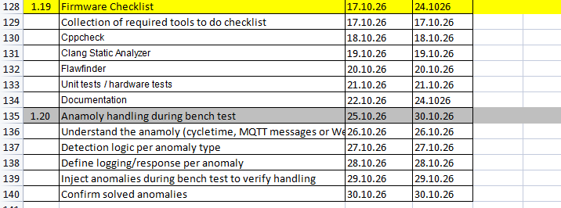
Next week plan tasks
S NO | NAME | PROJECT | PLAN TASK | START DATE | END DATE | COMMENTS
1 | Rithani | Gateway device | Firmware checklist | 15.10.26 | 24.10.26
WBS for next week planned tasks

Slide 7
Planned tasks
S NO | NAME | PROJECT | PLAN TASK | START DATE | END DATE | COMMENTS
1 | Aswin | Gateway Device | Learning and implementing enclosure design | 12.10.26 | 17.10.26
Actual tasks
S NO | NAME | PROJECT | TASK | START DATE | END DATE | COMMENTS
1 | Aswin | GATEWAY DEVICE | Created assembly template and work on it with tutorials. | 12.10.26 | 12.10.26
2 | Aswin | GATEWAY DEVICE | Export the 3D files and designed the pcb reference board | 12.10.26 | 13.10.26
3 | Aswin | GATEWAY DEVICE | Verify the Dimensions and thicknes for the reference board | 13.10.26 | 13.10.26
4 | Aswin | GATEWAY DEVICE | Redesign the issue parts in teh pcb refence board | 13.10.26 | 14.10.26
5 | Aswin | GATEWAY DEVICE | Designed the base plate of the enclosure and the mounting holes | 14.10.26 | 14.10.26
6 | Aswin | GATEWAY DEVICE | Verify the Dimensions of the Base plate and design connector cutouts | 15.10.26 | 16.10.26
7 | Aswin | GATEWAY DEVICE | Redesign the connector cutouts | 16.10.26

Slide 8
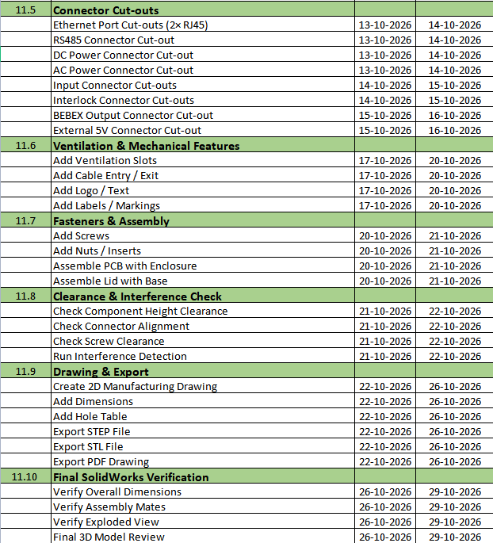
Next week plan tasks
S NO | NAME | PROJECT | PLAN TASK | START DATE | END DATE | COMMENTS
1 | Aswin | Gateway device | Complete and verify enclosure design | 10.10.26 | 29.10.26
WBS for next week planned tasks

Slide 9
Planned tasks
S NO | NAME | PROJECT | PLAN TASK | START DATE | END DATE | COMMENTS
1 | Noufal | Industrial Robot | Requirement collection for the robot | 12.10.26 | 14.10.26
2 | Noufal | Industrial Robot | Initiate AC servo testing | 15.10.26 | 17.10.26
3 | Noufal | Air bag Stitch inspection | Explanation of the project to SMD people | 12.10.26 | 12.10.26
4 | Noufal | Air bag Stitch inspection | Conduct weekly meeting on stich detection project progress | 16.10.26 | 16.10.26
Actual tasks
S NO | NAME | PROJECT | TASK | START DATE | END DATE | COMMENTS
1 | Noufal | Air bag Stitch inspection | Raspberry pi integration with ribbon camera, OS re installation | 12.10.26 | 31.10.26
2 | Noufal | Robot | Firmware ideation and WBS provided | 16.10.26 | 17.10.26

Slide 10
UNIVERSAL GATEWAY DEVICE COST DETAILS
S No. | Milestone Payment % | Milestone Payment Description | Amount (₹) | Planned Invoice Date | Actual Invoice Date | Invoice No. | Payment Status | Remark
1 | 0% | PHASE 1 DEVICE | ₹6,000 | NOV-2026 |  |  | Pending | WAITING FOR APPROVAL AT SMD
2 | 0% | PHASE 2 DEVICE | ₹29,000 | NOV-2026 |  |  | Pending | WAITING FOR APPROVAL AT SMD
3 | 0% | WORK BENCH COMPONENTS | ₹85,753 | NOV-2026 |  |  | Pending | WAITING FOR APPROVAL FROM MD
Total | 0% |  | ₹1,17,753

Slide 11
S No. | Vendor | Cost | PO Stage 1: quotation and vendor details collection | PO Stage 2: vendor code creation | PO Stage 3: Component info creation | PO Stage 4: PO generation | PO Stage 5: profama invoice from vendor | PO Stage 6: payment from our side | Remark
1 | Robu - gateway | 31,833 | ✅ | ✅ | ✅ | ✅ OCT 5 | ✅ OCT 14 |  | in stock - 7 days out stock - 40 days
2 | Sharvi - gateway | 3,833 | ✅ | ✅ | ✅ | ✅ OCT 5 | ✅ OCT 15 |  | Vendor side waiting
3 | Element14 - gateway | 2,489 | ✅ | ✅ | ✅ OCT 6 | ⏳ |  |  | Vendor wont create ASN for further process
4 | Vichrak - vamaan board | 18,999 | ✅ OCT 8 | NA | NA | NA | NA |  | Yet to recieve
5 | Robu - pi, cam, for stich detection | 6,935 | ✅ OCT 8 | NA | NA | NA | NA | ✅ OCT 16 | Recieved components
6 | Amazon - encloser for stich detection | 500 | ✅ OCT 8 | NA | NA | NA | NA |  | Yet to recieve
7 | Robu - Workbench | 31,636 | ⏳ |  |  |  |  |  | Waiting for MD aprroval
8 | Sharvi - workbench | 18,763 | ⏳ |  |  |  |  |  | Waiting for MD aprroval

Slide 12
THANK YOU

